Slide 1

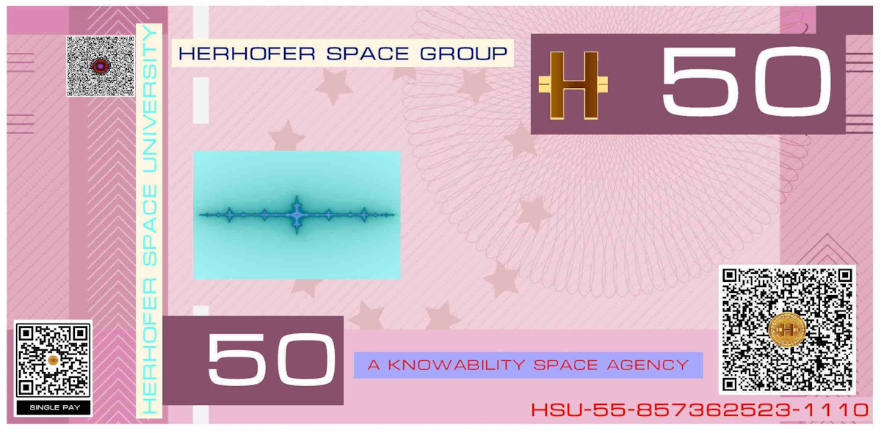

GALACTIC SERVICES SPACE

Slide 2
GALACTIC SERVICES SPACE
Beijing
Galactic Global Business
Representative and Head Office
ONE GALACTIC CURRENCY
SCRAMHERHOFER NET WORTH

Slide 3
GALACTIC SERVICES SPACE
Head office London – present office
Zurich Office Aerospace – to be opened
Herhofer Quality House Geneva Office – to be opened
All financial operations are executed via single currency denoted to local any country in the world at Herhofer Net Worth,
In Europe HNW is denoted to EUR
In USA denoted to USD
In UK denoted to GBP
Only one UK accounting using HMRC approved exchange rates.
Payroll from UK in HNW/CHF = 1 CHF
No local accounting, paid in Herhofer Net Worth via Herhofer Stargate Network SCRAM currency
R&D, inventions, patents and financing quality, policies and regulations compliance world global and global galactic business
No local accounting paid in Herhofer Net Worth via Herhofer stargate Network SCRAM currency

